Slide 1




Student Performance Dataset Exploratory Data Analysis
Neha Roy (Data Analyst)
https://github.com/Neha2001roy
www.linkedin.com/in/neha-roy-6469311b2

Slide 2

About the dataset
This dataset includes scores from three test scores of students at a (fictional) public school and a variety of personal and socio-economic factors that may have interaction effects upon them.

Slide 3
Data Features:
Gender: Gender of the student (male/female)
EthnicGroup: Ethnic group of the student (group A to E)
ParentEduc: Parent(s) education background (from some_highschool to master's degree)
LunchType: School lunch type (standard or free/reduced)
TestPrep: Test preparation course followed (completed or none)
ParentMaritalStatus: Parent(s) marital status (married/single/widowed/divorced)
PracticeSport: How often the student parctice sport (never/sometimes/regularly))
IsFirstChild: If the child is first child in the family or not (yes/no)
NrSiblings: Number of siblings the student has (0 to 7)
TransportMeans: Means of transport to school (schoolbus/private)
WklyStudyHours: Weekly self-study hours(less that 5hrs; between 5 and 10hrs; more than 10hrs)
MathScore: math test score(0-100)
ReadingScore: reading test score(0-100)
WritingScore: writing test score(0-100)

Slide 4

Objective
The objective of analyzing the Student Performance dataset is multifaceted, aimed at understanding, exploring, and utilizing the data to gain insights into factors affecting student academic achievement.

Slide 5
Essential libraries used:
Pandas : It is a powerful library for data manipulation and analysis. It provides data structure like DataFrame and Series, which are essential for working with structured data.
Numpy : it is a fundamental package for numerical computing in python.
Matplotlib.pyplot: it is a comprehensive library for creating static, animated and interactive visualizations in python.
Seaborn: it is a python visualization library based on matplotlib.
Import warnings: This line imports the warnings module which provides functions to issue warnings.
Warnings.filterwarnings("ignore"): This line sets up a filter to ignore all warnings.

Slide 6
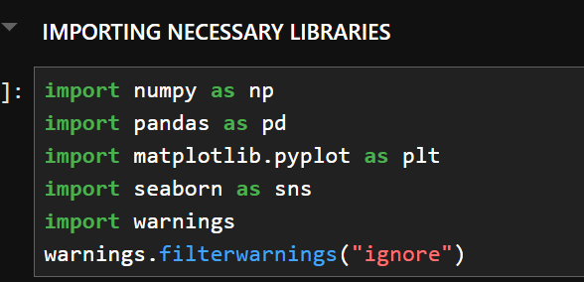
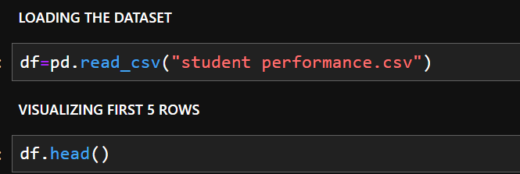
STEP 1: Exploratory Data Analysis - Data Collection

Slide 7
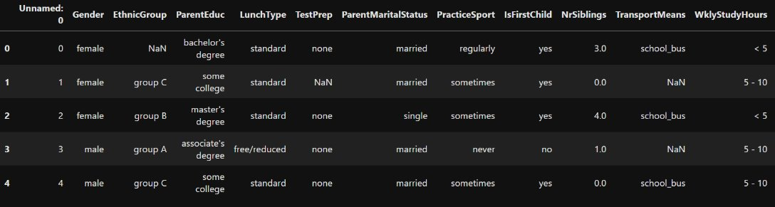
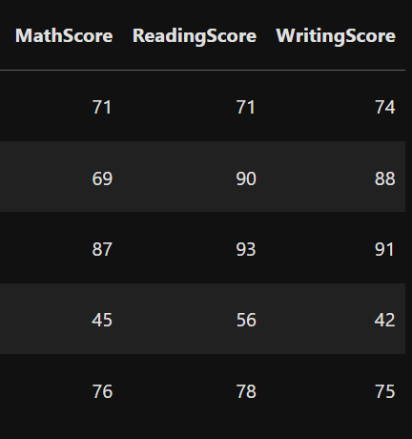

Slide 8
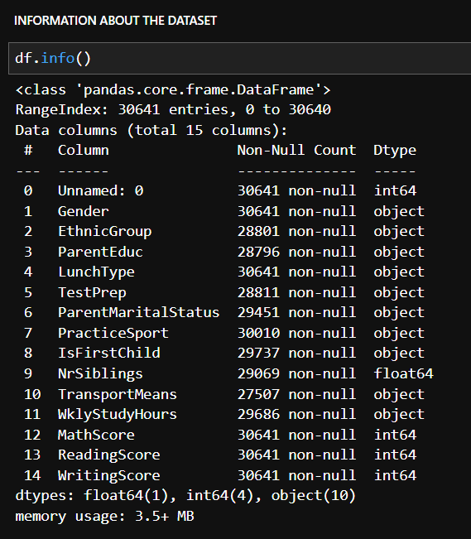
There are total 30,641 rows and 15 columns in which we have 1 float, 4 integer, and 10 object type column containing categorical data.

Slide 9
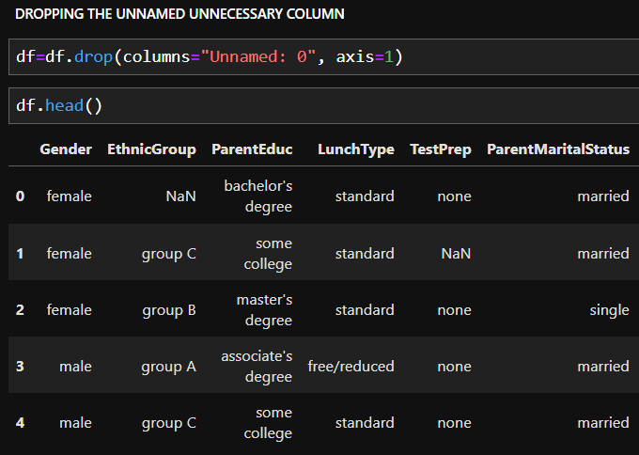
Since there was an unnecessary column named "Unnamed: 0", we had to drop it.
STEP 2: Data Cleaning

Slide 10
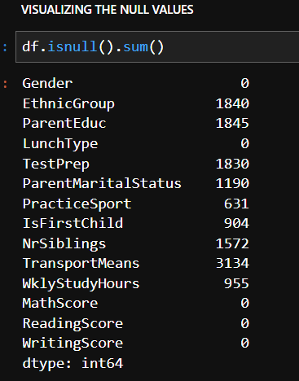
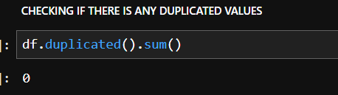
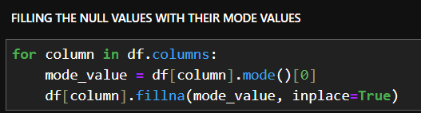

Slide 11
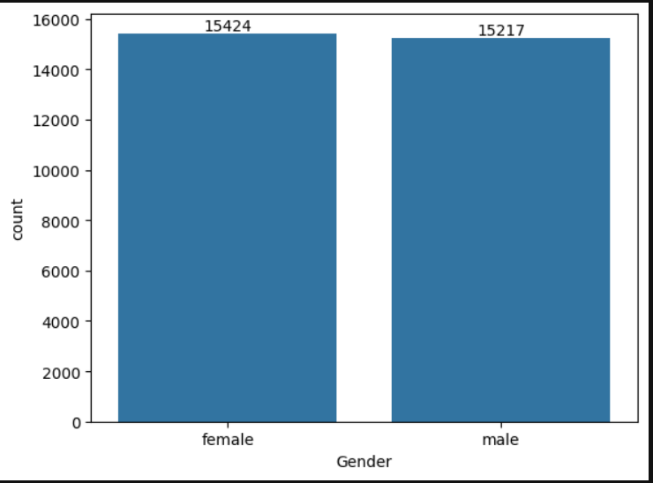
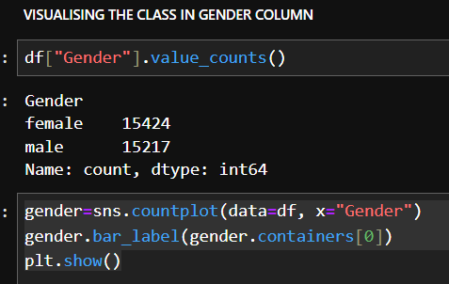
STEP 3: Data Exploration & Visualization

Slide 12
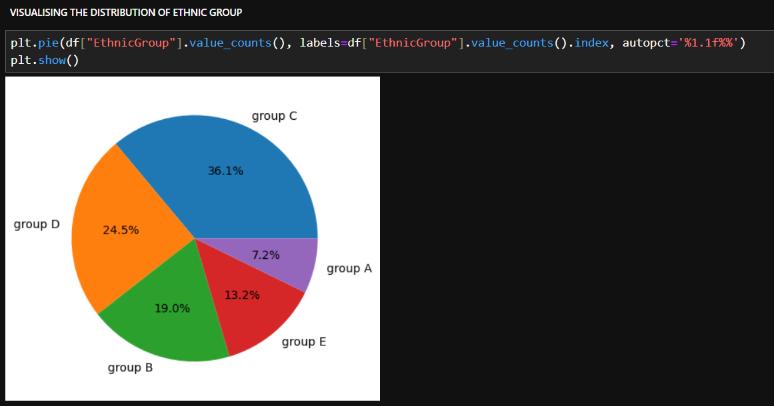

Slide 13
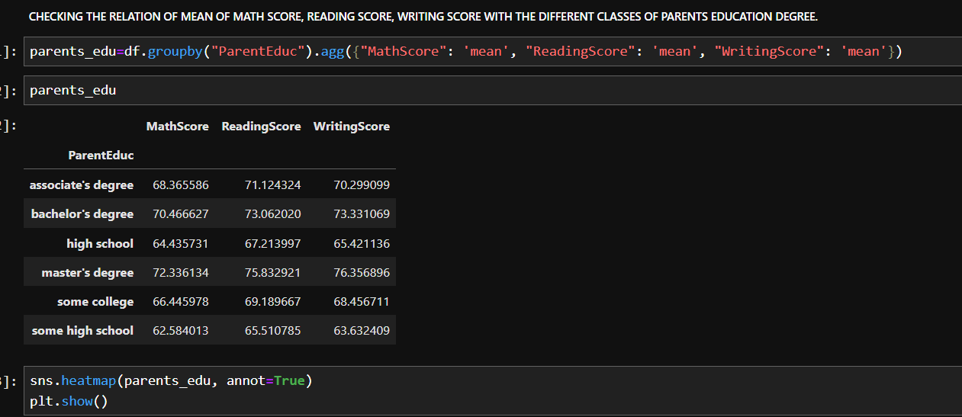

Slide 14
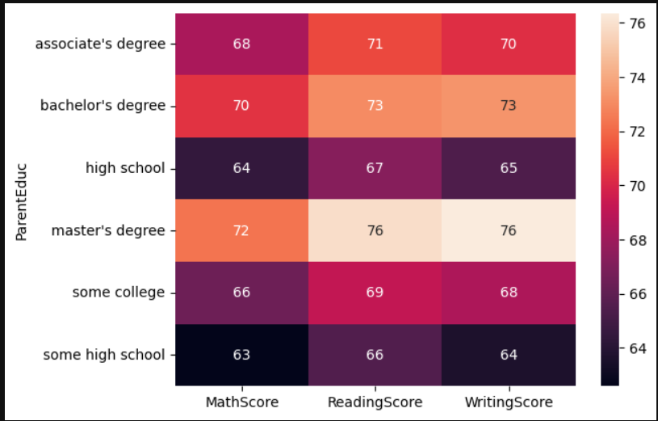

Slide 15
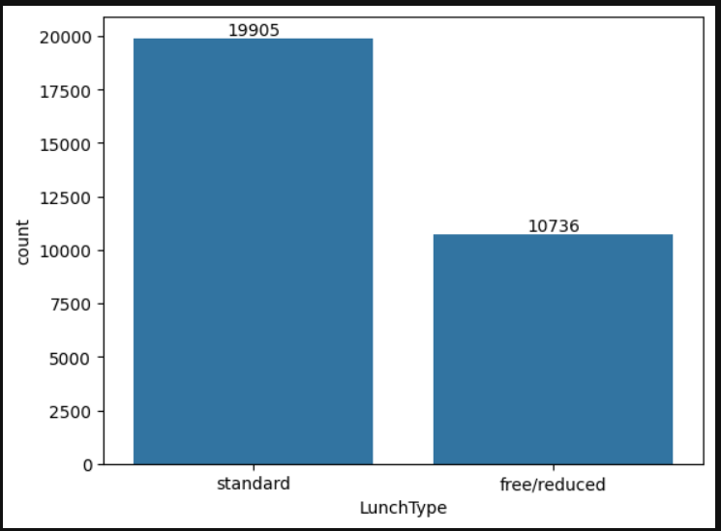
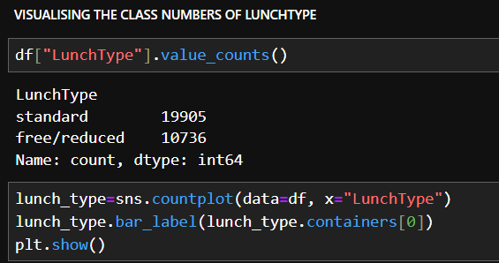

Slide 16
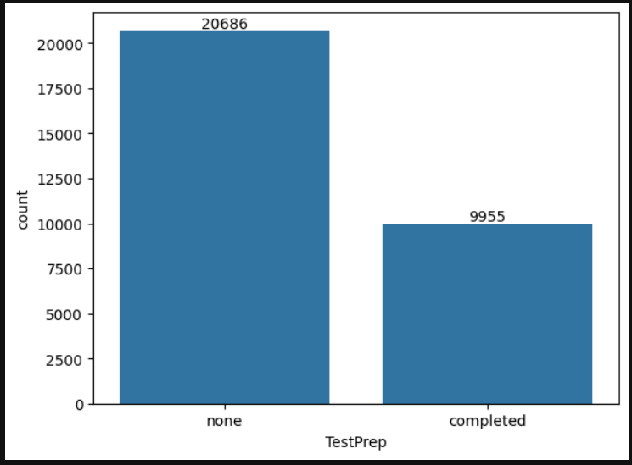
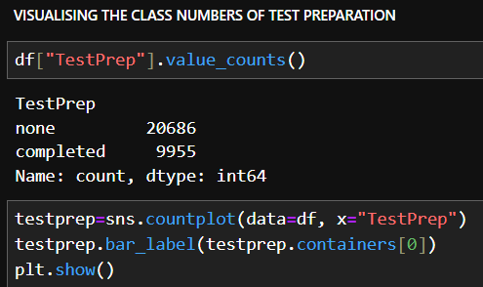

Slide 17
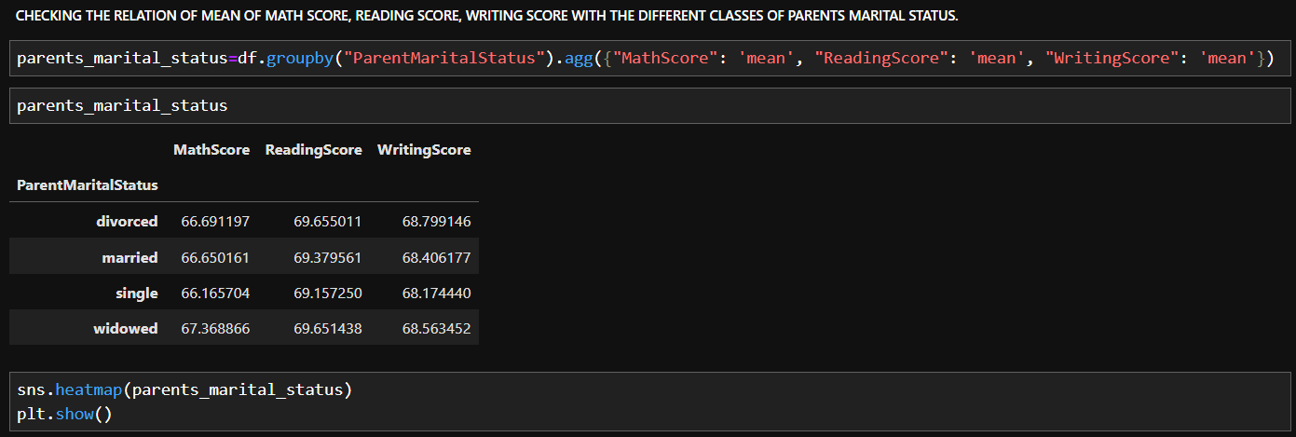

Slide 18
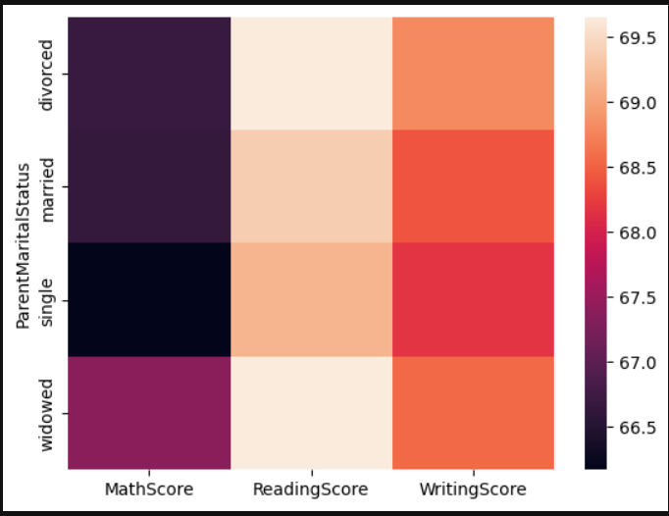

Slide 19
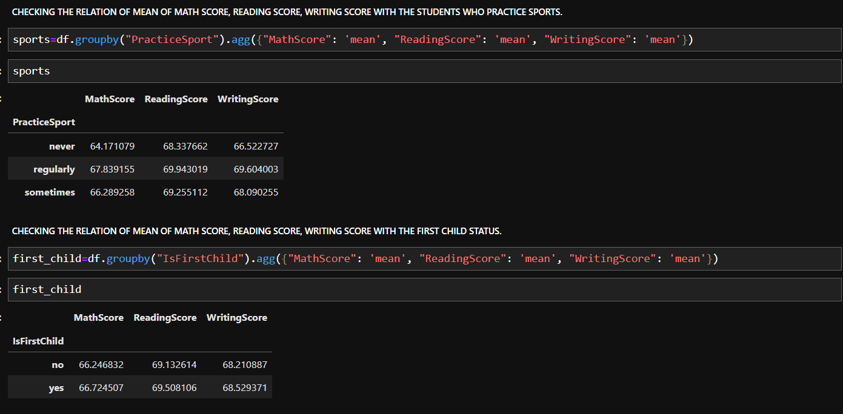

Slide 20
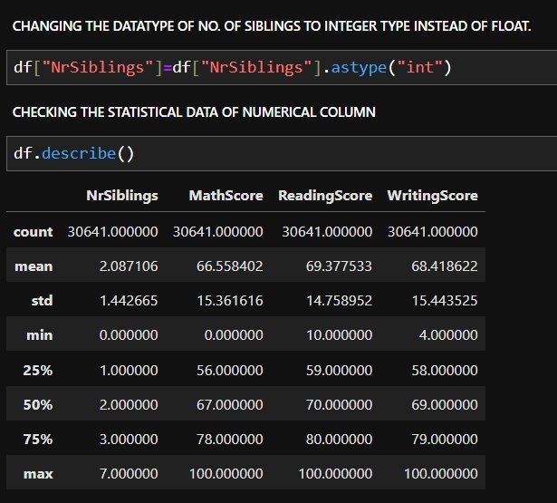

Slide 21
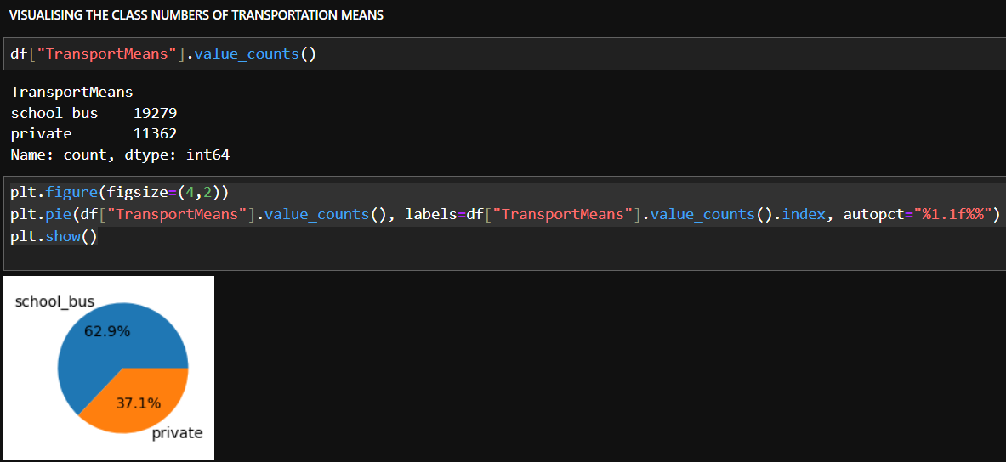

Slide 22
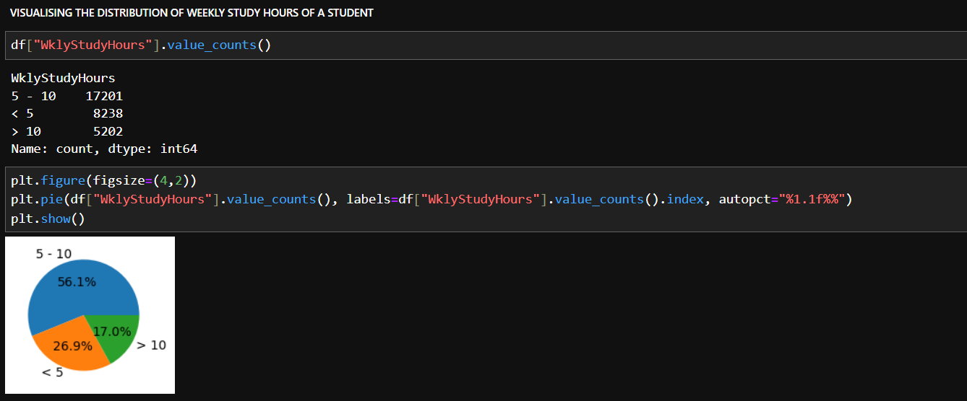

Slide 23




Slide 24
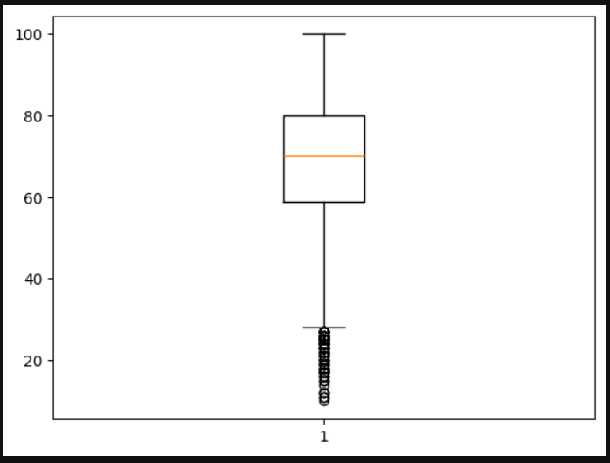
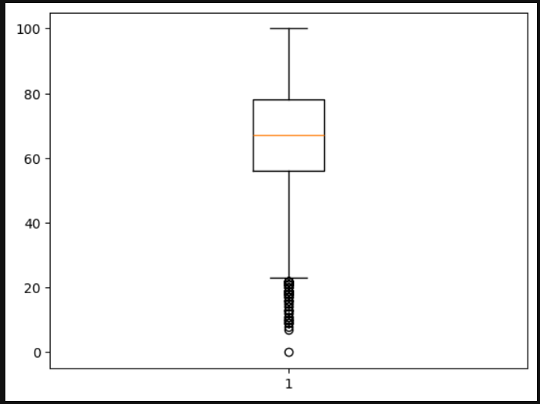
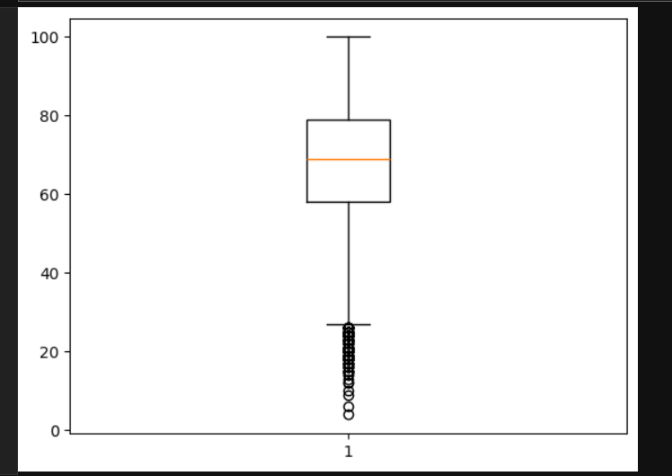
MATH SCORE
READING SCORE
WRITING SCORE

Slide 25
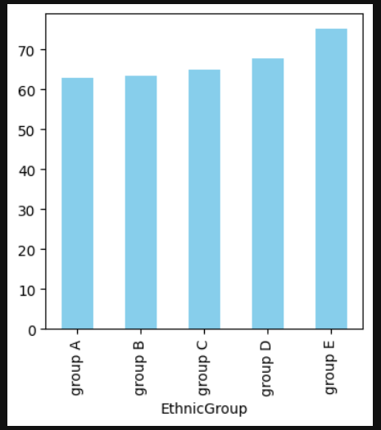
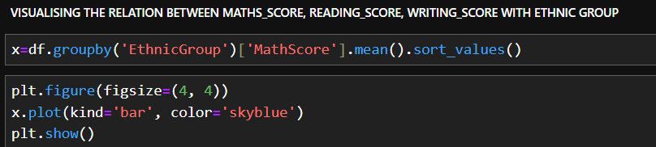

Slide 26
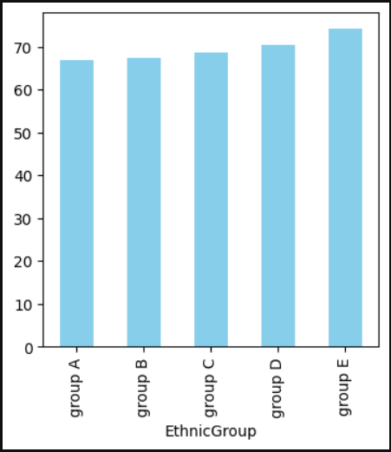
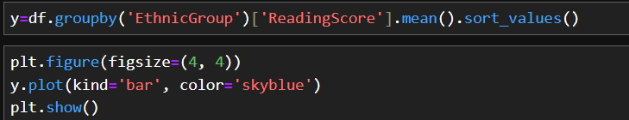

Slide 27
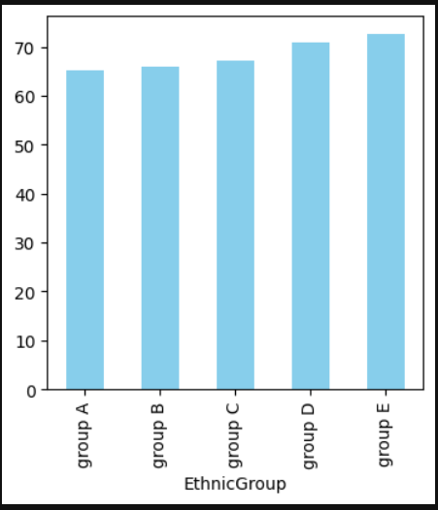
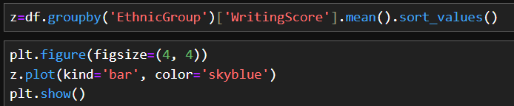

Slide 28
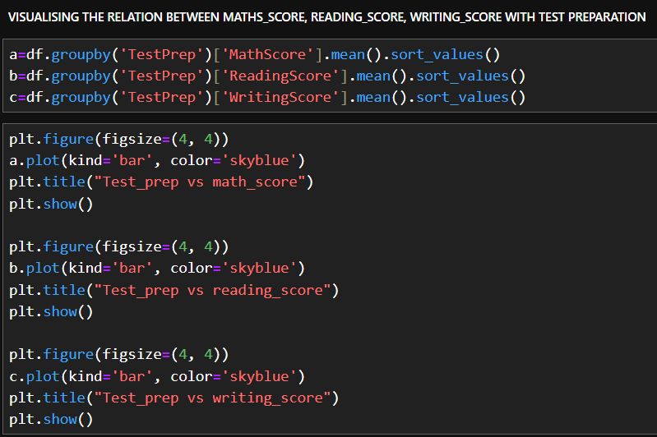

Slide 29
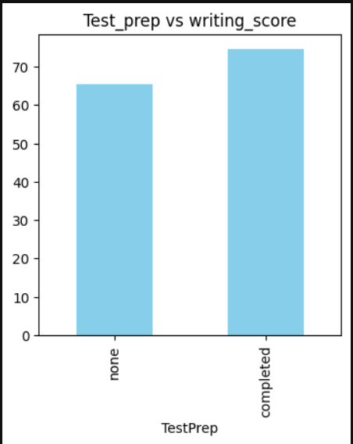
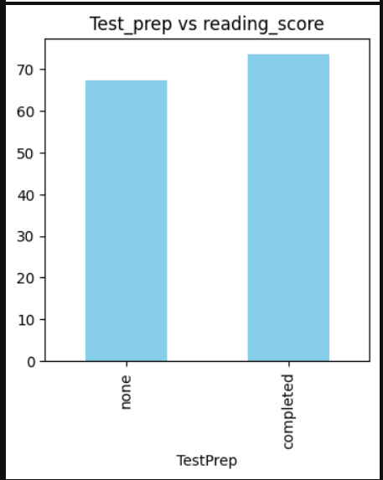
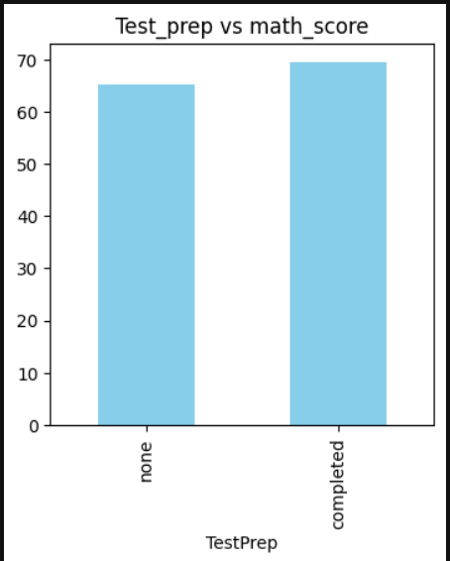

Slide 30

SUMMARY:
There were many null values, which was been replaced by their mode values.
The count of males were lesser than the females.
The distribution of group C in ethnic group was the highest i.e. 36.1% and group A was the least.
It was visualized that the student's score were highest, if their parents had a master degree and the score were less when the parent had only the high school degree.
The count of standard type of lunch were more than the free/reduced type.
It was observed that less number of students were prepared for the test.
It was seen that there was no significant effect of parent's marital status with the math, reading and writing score.
There is no significant relation between the scores obtained by students who played sports regularly, play sometimes or never play sports.
It was seen that students score less marks in maths as compared to reading and writing.
The ethnic group E scores highest and group A scores the least.

Slide 31


